Slide 1
Artistic Style Transfer Using Convolutional Neural Networks(CNN)

Slide 2
By:
Ruturajsinh Vihol (Rue) - 40154693
Shibin Koshy - 40295019
Bhavya Ruparelia - 40164863

Slide 3
Introduction & Motivation
"Why Artistic Style Transfer?"
Notes:
Do more on the how and what
Met : Thursday Sept 19th,
1pm outside class determined point of contacts and set routine
meetings duration: 15mins
Met September 20th, Friday at 2pm.
Meeting lasted 1 hour.
Mapped the functions to individuals and started on a collaborative google document.
Met September 27th, Wednesday at 2pm,
Meeting lasted 1 hour
Reviewed week’s work and created interview questions for the preceding week.
Met october 5th, Saturday at 3pm
Emergency Meeting lasted 1 hour
Discussed how we will proceed with the latex document and split the work between all the group member
Met october 10th, Thursday at 3pm
Emergency Meeting lasted 1:20 minutes
We went over how we are going to organize the interviews personas and use cases into one unified document and to make sure everyone is doing their parts
Met October 17th, Thursday at 1pm
Meeting lasted 3 hours in person
Finalized the presentation and the interview document
We meet outside of class on the 19th, we all agree to have our first meeting tomorrow as we have the same lab. Our first meeting is all about setting up the tools for working and communicating, which days we can all meet up and discuss, and what we are going to to do in this project.

Slide 4
Balance of Art & Technology: Combines technical aspects of neural networks with artistic creativity, making it an exciting and interdisciplinary topic
Motivations:Growing Impact:
Research Potential: Extending style transfer for better control over content vs. style balance.
Style transfer is widely used in creative industries and modern AI models.
Widespread Applications:
Digital Art & Design: Enhances creativity in producing artistic images. Best ex: ANIME
Photo Editing Apps: Used in popular apps (e.g., Prisma).
AI Models: Forms the basis for advanced models like DALL-E and image generation tools.
Why we choose this topic and paper??

Slide 5
Background & Related Work
"Inspired by Gatys et al. (2016)"

Slide 6
Foundational Work of Gatys et al. (2016):
Foundational Work: Gatys et al. (2016) pioneered style transfer using deep learning.
First to Use CNNs: Leveraged Convolutional Neural Networks (CNNs) to separate content and style effectively.
Impact: Demonstrated that CNNs trained for object recognition can generate high-quality artistic images.
Methodology:
Content Representation: Extracted from higher layers of a pre-trained VGG network to capture objects and structure.
Style Representation: Used a Gram matrix to capture correlations between different feature maps to represent style.
Optimization: Combined content and style loss functions to synthesize an image that blends both.
Notes:
Pair Programming: Visual Studio Code with live collaboration features.
Code Reviews and Version Control: Git for managing code revisions and conducting reviews.
Communication: Discord, Google Meets, Google calendar and in-person for team meetings and real-time discussions.
Documentation: Notion and Google Docs for maintaining and sharing documentation, and tracking process (we set a specific deadline and keep track).
LaTeX Document Submissions: Overleaf for preparing and submitting LaTeX documents.
This concise table covers the patterns and tools your team is using. Let me know if you'd like further adjustments!
Explain more about how we use the tools
Google meets (for meetings and interviews)
Google Calendar (for setting up the date of meeting)
Notion - keep track of progress

Slide 7
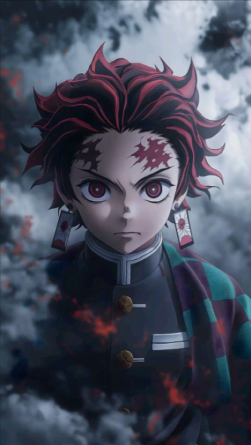
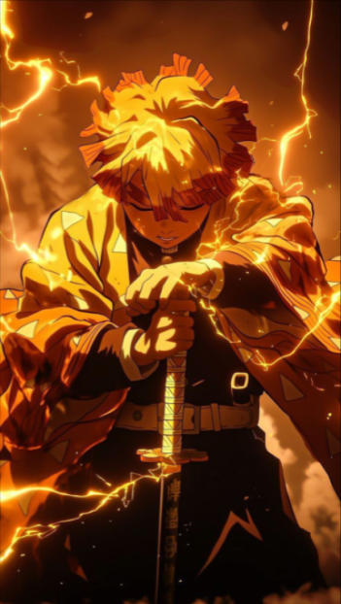
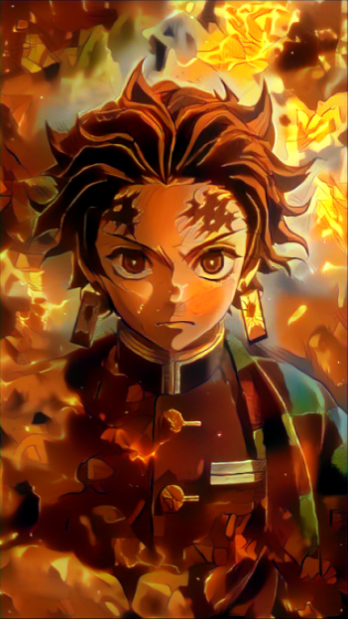
Content Image
Style Image
Output Image

Slide 8
Project Goal
Goal of the Paper:
Synthesize an Image: Combine the content of one image with the style of
another using Convolutional Neural Networks (CNNs).
Significance:
Novel Approach: First method to effectively separate content and style using CNNs, specifically leveraging networks trained for object recognition.
Project Goal:
Achieve Balance: Aim to balance content preservation and style representation using VGG16 and evaluate potential enhancements with VGG19.
Main Challenge:
Finding the Right Balance: Optimize weighting factors to ensure content and style are effectively merged without overpowering each other.

Slide 9
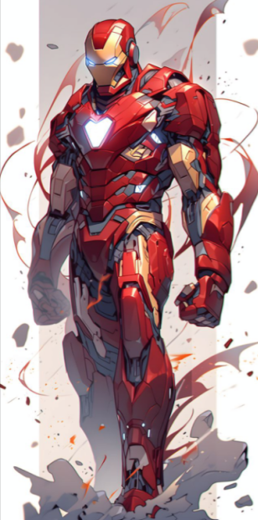
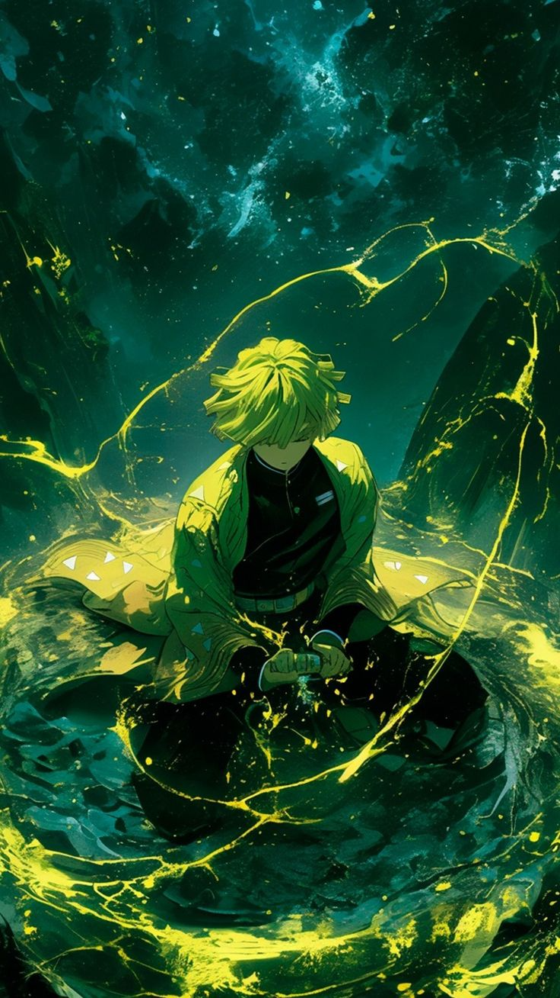
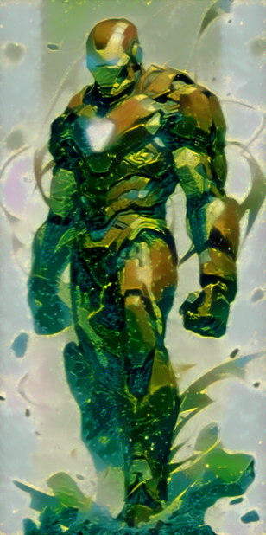
Content Image
Style Image
Find right balance between style
and content to merge

Slide 10
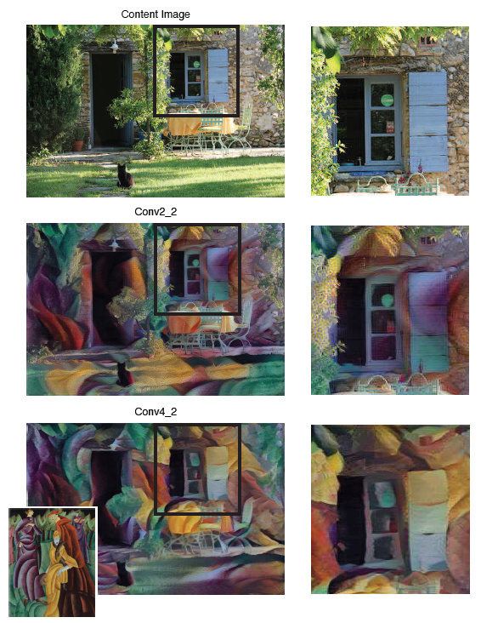
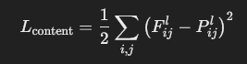
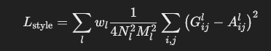
Methodology and Algorithm
Deep Image Representations:
Uses a pre-trained VGG network to extract hierarchical features.
Separates content and style using different layers.
Content Representation:
High-level features from deeper layers (e.g., conv4_2).
Preserves spatial arrangement and object structures.
Loss: Squared error between feature maps of content and generated image.
Style Representation:
Captures textures via Gram matrices (filter correlations) across layers.
Multiscale representation for global and local style matching.
Loss: Squared error between Gram matrices of style and generated image.

Slide 11
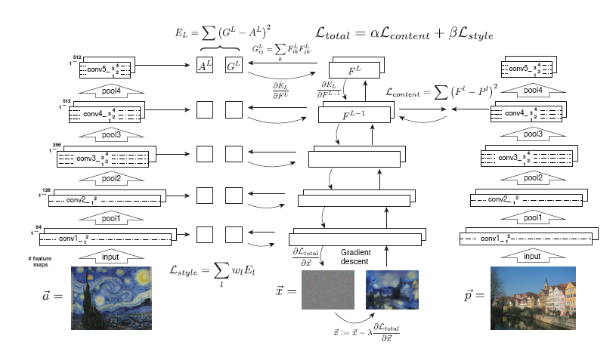
Methodology and Algorithm
Combined Loss Function:
Total Loss = α (Content Loss) + β (Style Loss)
α = Weight for content, β = Weight for style
Output varies according to α/β ratio (1e-1 to 1e-6)
Optimization:
L-BFGS (Quasi-Newton method approach)
Adam (Gradient descent approach)
Iteratively updates the pixels of a random noise image or the style image till convergence. Learning rate and iterations are updated inversely (lr=0.1, iter = 500).

Slide 12
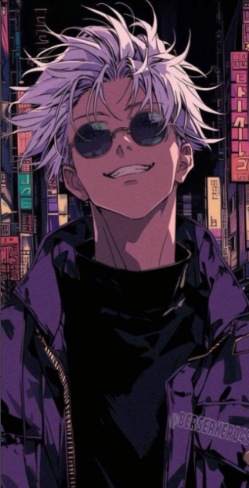
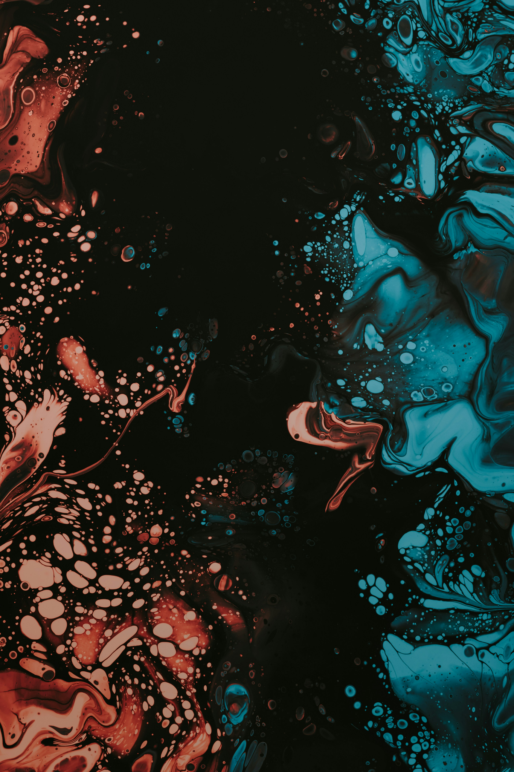
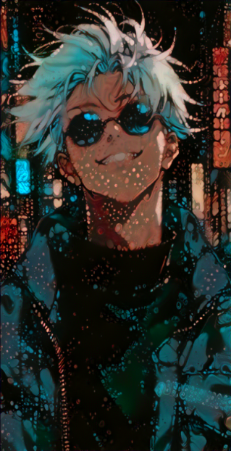
Methodology and Algorithm
Goal: Blend content of photo with style of artwork.
Key Finding: Representations of content and style in the Convolutional Neural Network are well separable.
Result: New image combining content and style.

Slide 13
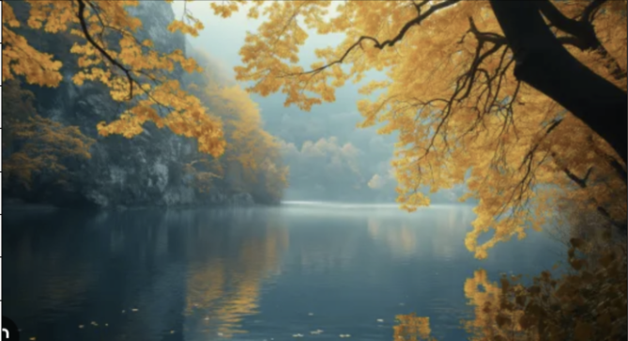
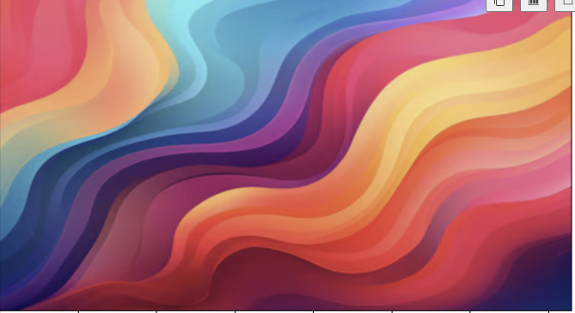
Results & Comparison
Preservation of Semantic Content:
“The style transfer model preserves the semantic content of the source image while releasing the texture, color, and patterns extracted from the style image.”
Context Image
Style image

Slide 14
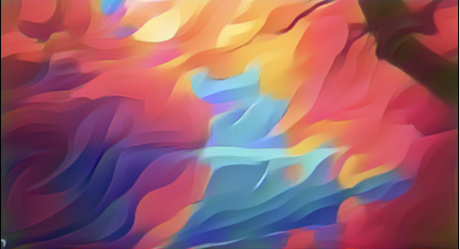
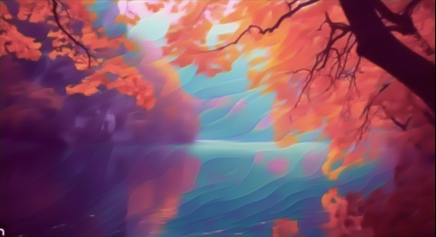
Control with Weight Ratios:
“By varying the weight ratio of content and style representations, we can balance preserving the original content versus transferring the style.”
“Low α/β
A lower ratio prioritizes style loss, creating outputs that strongly reflect the artistic characteristics of the style image.”
“High α/β
A higher ratio emphasizes content preservation, maintaining the original structure of the source image.”
Low α/β
High α/β

Slide 15
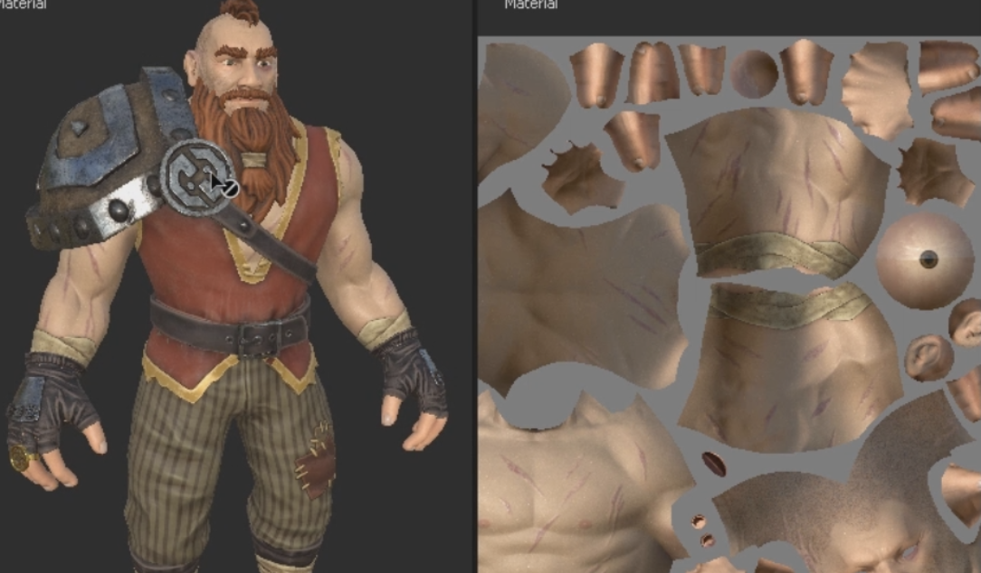
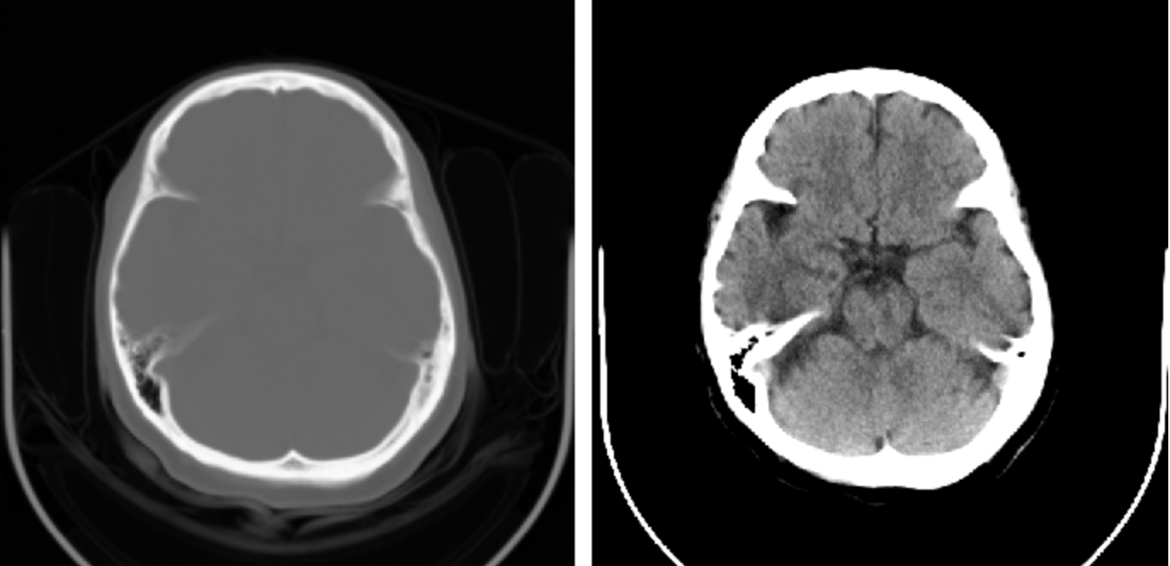
Application of the Style Transfer model
Video Production:
“Create a distinctive visual aesthetic in video frames for animations or movies.”
Branding and Advertising:
“Generate unique designs for branding, marketing, and advertising campaigns.”
Gaming Development:
“Apply specific artistic styles to game characters and landscapes to create unique, immersive worlds.”
Medical Imaging:
“Enhance raw brain scan images (e.g., MRI or CT scans) by adding patterns, textures, or contrasts. Highlight different brain regions or abnormalities, making them easier to identify and interpret.”

Slide 16
Challenges of this model
For running the model in devices with limited resources, such as mobile phones or embedded systems.
Style transfer, especially using diffusion models and deep neural networks, is computationally expensive and requires high-end GPUs for real-time applications.
Which makes the Processing delays for high-resolution images can hinder usability in interactive applications.

Slide 17
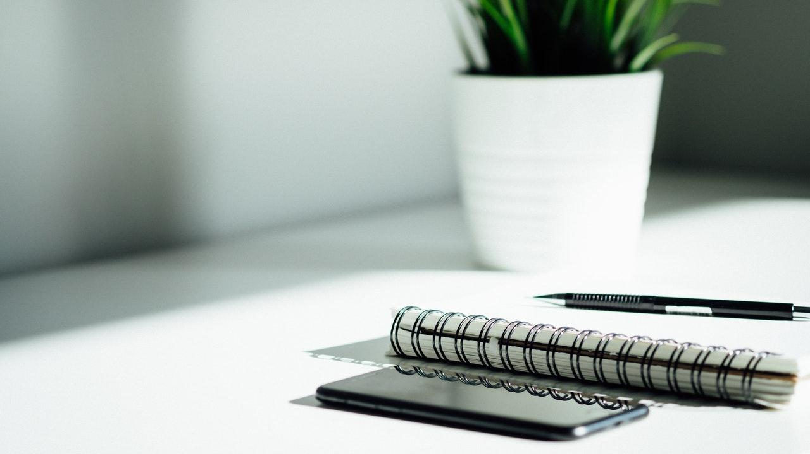

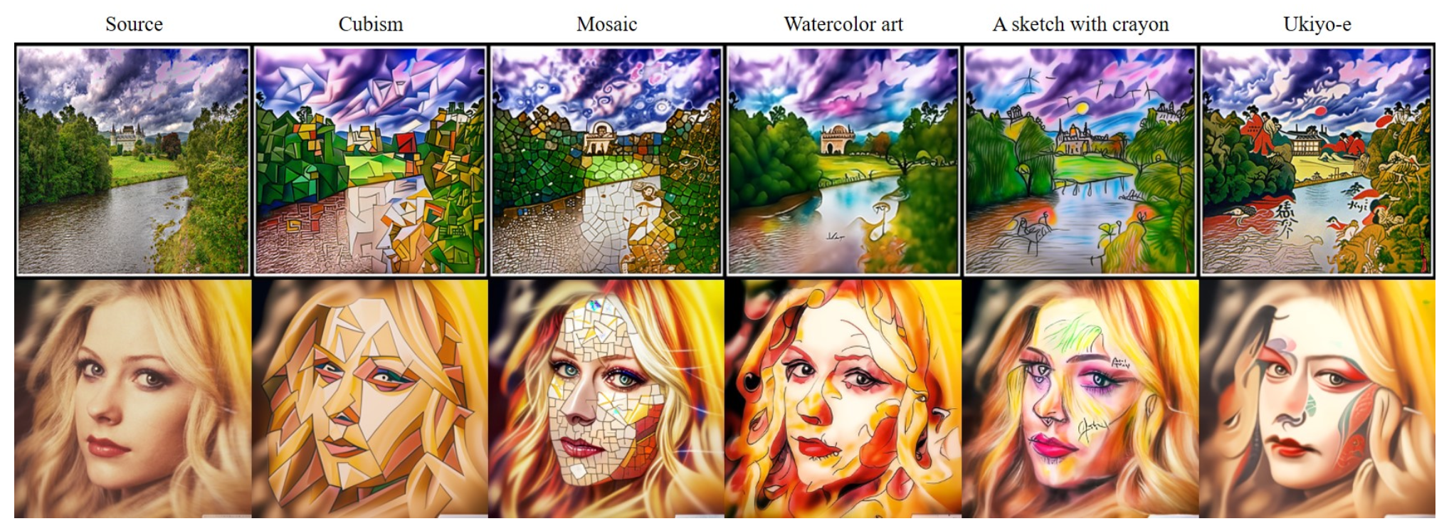
Future Work
Automation and Adaptability
Leverage reinforcement learning or meta_learming to automate the tuning of parameters like α/β based on input content and style.
Train models on broader datasets with diverse styles and in
corporate domain adaptation techniques to improve the adaptability of zero-shot approaches to handle unseen styles and content.
Enable style transfer guided by text or other inputs for enhanced creative flexibility.
Efficiency and Scalability
Develop lightweight and efficient algorithms for real-time style transfer
Enable style transfer for ultra-high-definition (UHD) images and videos without loss of detail or increased artifacts.

Slide 18
Summary & References
To summarize: Our project aimed to combine the content of one image with the style of another using CNNs, achieving an effective balance between content preservation and artistic transformation.
Key Takeaway: Comparison between VGG16 and VGG19 showed that VGG19 provided finer style details, but VGG16 achieved a better balance between content clarity and stylization.
Reference: Gatys, L. A., Ecker, A. S., & Bethge, M. (2016). Image Style Transfer Using Convolutional Neural Networks. Proceedings of the IEEE Conference on Computer Vision and Pattern Recognition (CVPR), Las Vegas, NV, USA, 2016, pp. 2414-2423. https://doi.org/10.1109/CVPR.2016.265
Notes:
Mention some examples that is mentioned in the doc that reflected the process

Slide 19
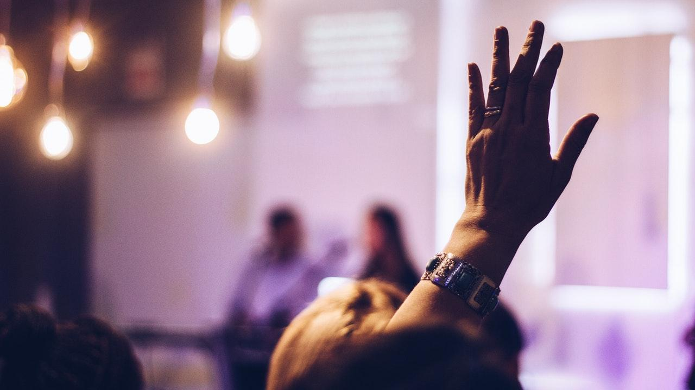
Discussion & Q&A
THANKS!
Any questions?
Prompt question:
"What real-world applications can you see for style transfer that you have used before or would like to see?"

